Slide 1
Thesis Defense An alternative data structure to Line Sweep Algorithm
Tushar S. Jadhav
Computer Science Department
San Diego State University
August 14th, 2012

Slide 2
Computational Geometry
Branch of computer science dedicated for study of geometric algorithms.
Useful to solve a lot of real world problems.
Application areas include robotics, artificial intelligence, CAD/ CAM, city planning, Geographic Information Science (GIS), decision making and many more.

Slide 3
Line Sweep Algorithm
One of the most popular algorithm in computational geometry.
Useful in a lot of areas, most commonly in the map overlay problem.
Why is finding intersection points among lines not a trivial task?

Slide 4
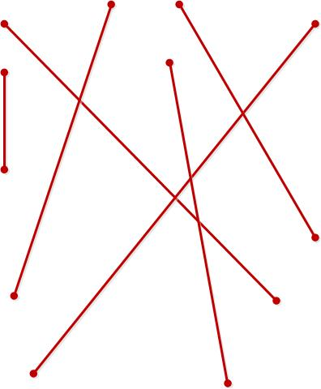
Algorithm (continued…)
Consider the following random lines -

Slide 5
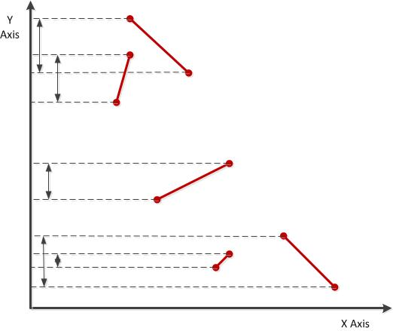
Algorithm (continued…)
Lines showing their orthogonal projection onto Y axis -

Slide 6
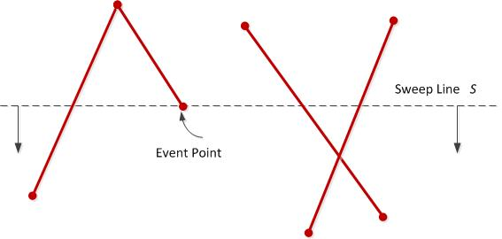
Algorithm (continued…)
Event point of sweep line -

Slide 7
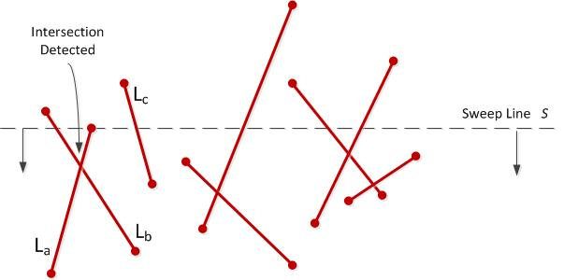
Algorithm (continued…)
Snapshot when intersection point was detected -

Slide 8
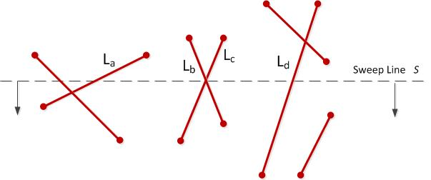
Algorithm (continued…)
Sweep line reaching at an intersection point -

Slide 9
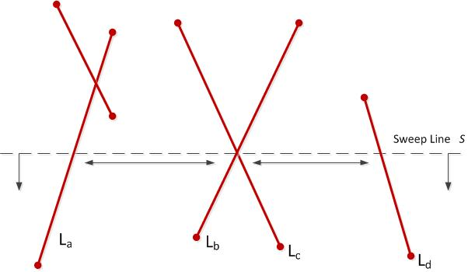
Algorithm (continued…)
Lines have new neighbors -

Slide 10
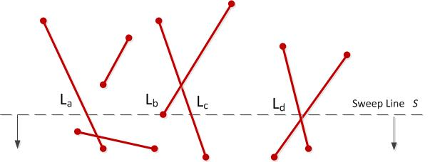
Algorithm (continued…)
Sweep line passing through lines -

Slide 11
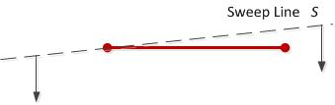
Algorithm (continued…)
Sweep line passing though a horizontal line -

Slide 12
Data structures
The two most important data structures used in the algorithm are:
1. The event queue
2. The status structure
What are these data structure used for?
How are they implemented?

Slide 13
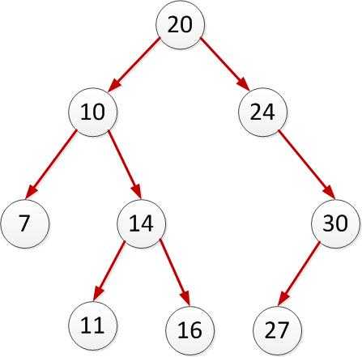
Binary Search Tree
A simple binary search tree

Slide 14
AVL Tree used by the algorithm
Each internal node must store the right-most leaf in its left subtree. In other words each internal node must store it’s “in order predecessor”.
The left to right order of the leaves of the tree should correspond to its left to right order in the Cartesian coordinate space.
Quite a challenge to implement such an AVL tree programmatically with functions such as “Add” and “Remove”.

Slide 15
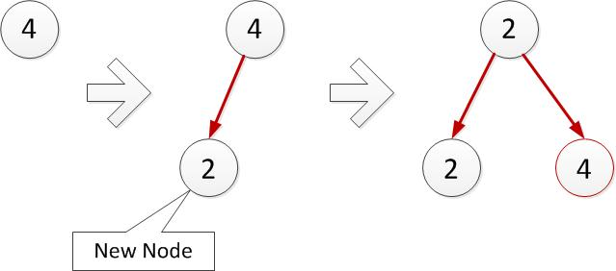
Adding new Left Leaf Node

Slide 16
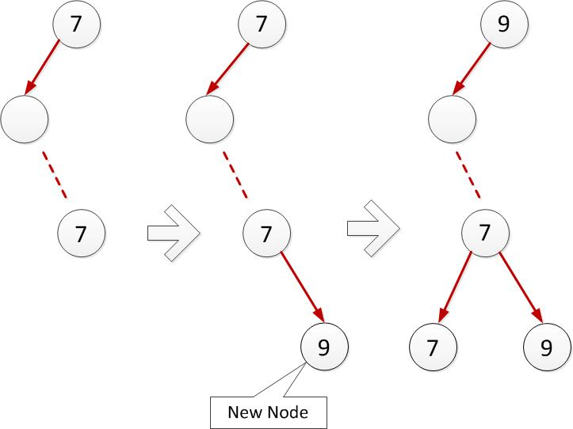
Adding new Right Leaf Node

Slide 17
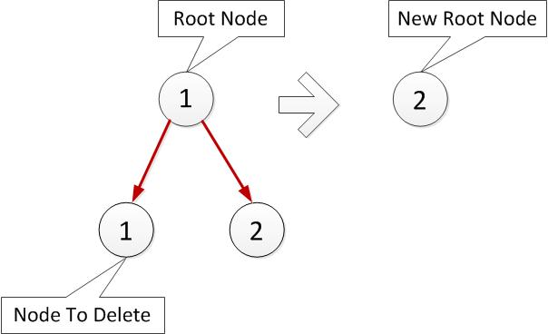
Deleting a node

Slide 18
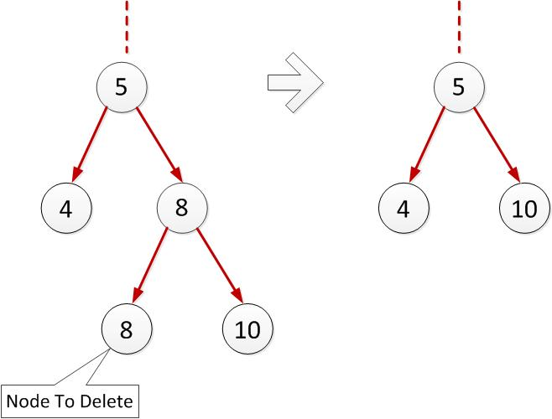
Deleting a Left Leaf Node

Slide 19
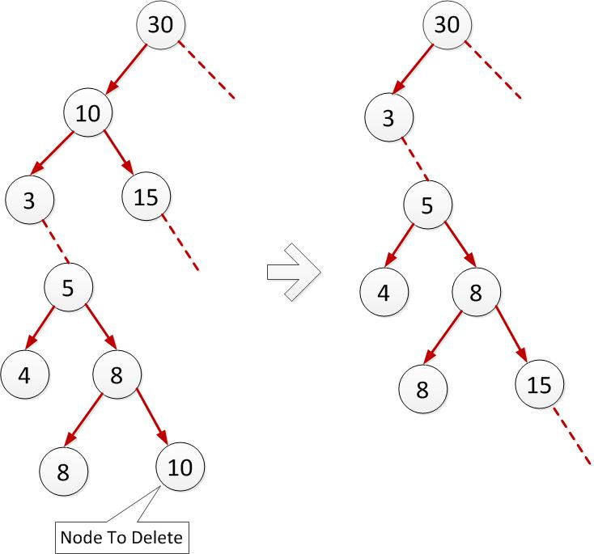
Deleting a Right Leaf Node

Slide 20
Room for performance?
The single most heavily performed operation on the AVL tree is finding the left and right neighbor.
Used extensively thought the algorithm iteratively multiple times.
According to the current implementation, it requires O(log n) time to compute the immediate neighbor.
Performance when the tree contains millions of nodes?

Slide 21
Theme of the thesis…
Store pointers to the left and right neighbor’s only in the leaf nodes.
These pointers are maintained as the tree is gradually evolved.
Now the neighbor finding operation is done in constant time O(1) which is a huge improvement.

Slide 22
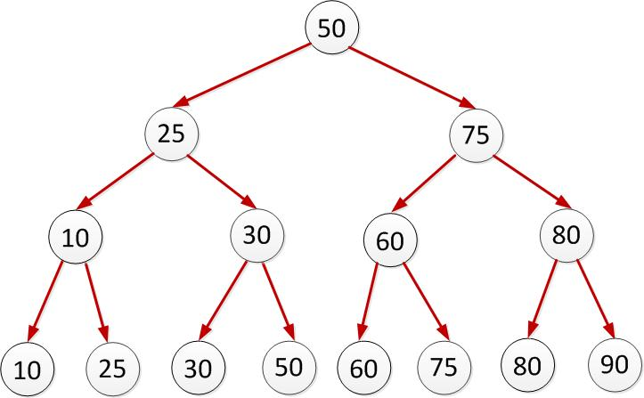
Theme of the thesis…

Slide 23
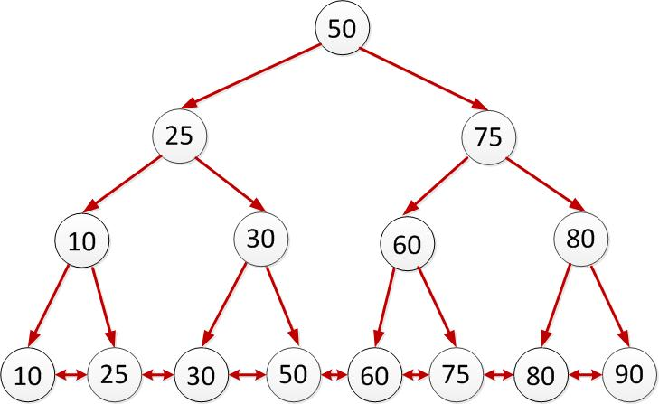
Theme of the thesis…

Slide 24
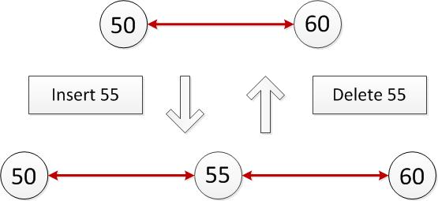
Theme of the thesis…

Slide 25
Is this an extra overhead?
Will these extra pointers be an extra overhead during …
Addition of a node
Deletion of a node
Tree rotations
What about space complexity?

Slide 26
Other things learnt
Don’t under estimate memory leaks and how to detect them?
Source control the code for better versioning and maintenance.
Importance of Unit tests.
Power of C++ templates.
Design patterns

Slide 27

Demo

Slide 28
Future enhancements
Refactor the code according to the recent MVVM (Model-View-View Model) design pattern.
Provide a Graphical User Interface (GUI) in ActiveX Control, WPF or Silverlight.
Submit the project to the ”CGAL” (Computational Geometry Algorithms Library) open source community after thorough testing.

Slide 29
Thank You
Questions?

